Slide 1
IEEE AND ITS ACTIVITIES

Slide 2
INTRO
1

Slide 3
BASIC IDEA
Institute of Electrical and Electronics Engineers
Professional Association
World's Largest

Slide 4
Formation
AIEEE
IEEE
IRE

Slide 5
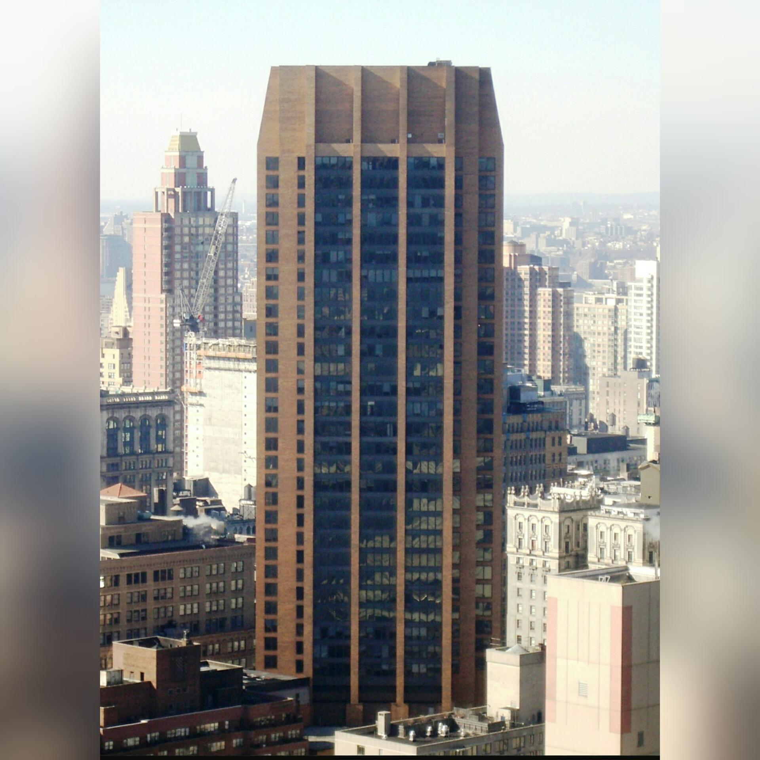
WORK PLACE
Corporate office in New York City.
Operation center in New Jersey.

Slide 6
Core Values
Trust
Growth and nurturing
Global community building
Partnership
Service to humanity
Integrity in action

Slide 7
Strategic Plan
2

Slide 8
Mission & Vision
Mission
IEEE fosters technological innovation and excellence for the benefit of humanity.
Vision
IEEE will be essential to the global technical community and to technical professionals everywhere, and be universally recognized for the contributions of technology and of technical professionals in improving global conditions.

Slide 9
Goals & Key initiatives
To provide technically vital forums
To solve the world’s most challenging problems
To provide more opportunities, products, and services
To evaluate and adapt organizational structures and processes
Notes:
Provide technically vital forums for the discussion, development, and dissemination of authoritative knowledge related to traditional technologies, while focusing more of our resources towards serving the professionals working on emerging and disruptive technologies.
Lead humanitarian efforts around the world to use technology to solve the world’s most challenging problems.
Provide more opportunities, products, and services aimed at increasing our value to professionals working in the industry; particularly younger professionals and entrepreneurs.
Evaluate and adapt organizational structures and processes to meet the demands of a changing environment while managing the financial and sustainable health of IEEE.

Slide 10
IEEE
Publishes more than 160 transactions, journals, and magazines.
Sponsoring more than 1,600 conferences in more than 80 countries.
Developed more than 1,600 standards and projects.
Having nearly 4 million documents in the IEEE Xplore® Digital Library.

Slide 11

MEMBERSHIP
3
Gain Expertise and Open Career Doors Stay Current and Get Ahead Build a Network
Notes:
IEEE is the leading professional association for the advancement of technology. With more than 400,000 members in more than 160 countries, IEEE is the world's largest technical professional society. Through its global membership, IEEE is a leading authority on areas ranging from aerospace systems, computers and telecommunications to biomedical engineering, electric power, consumer electronics, and many other technical areas. Members rely on IEEE as a source of technical and professional information, resources and services. To foster an interest in the engineering profession, IEEE also serves student members in colleges and universities around the world, advocates for the profession and helps to introduce technology careers to young people worldwide.

Slide 12

426,124
members in more than 160 countries.

Slide 13

“Advancing Technology for Humanity”

Slide 14
Characteristics of IEEE community
Professional
Social
Humanitarian
Notes:
These three pillars represent the core experiences that make up IEEE membership and the reason that nearly half a million technologists worldwide make IEEE an integral part of their lives. In this video, you will hear first-hand from both long-term and new members about why IEEE is so vital to them

Slide 15
IEEE MEMBERSHIP
STUDENT MEMBER
GRADUATE STUDENT MEMBER
MEMBER
SOCIETY AFFILIATES
SENIOR MEMBERS
FELLOW MEMBERS
HONORARY MEMBERS
LIFE MEMBERS
Notes:
Gain Expertise and Open Career Doors IEEE houses an unrivaled network of professionals, experts, and advisors that can help shape your career, offer resources to acquire new skills, advance your professional development, and provide numerous opportunities for involvement, recognition, and reward.
Stay Current and Get Ahead Membership grants you access to the largest library of electrical engineering, computer science, and electronics technical literature as well as the latest technology trends, industry news, and events.
Build a Network Collaborate with IEEE colleagues and member groups, online or in person, to build a support group for your profession, industry, o

Slide 16
IEEE MEMBERSHIP
STUDENT MEMBER
STUDENT MEMBER
Undergraduate or graduate students in technology or engineering.
Enrolled in an accredited institution of higher education
Student membership is available for a reduced fee
GRADUATE STUDENT MEMBER
Graduate Student Membership is discounted
Members at this level have greater privileges than do Student Members.
Limited membership time is to 8 years.
MEMBER
Graduated from a technology/engineering program of an accredited institution of higher education
Demonstrated professional competence in technology or engineering through at least six years of professional work experience
SOCIETY AFFILIATES
Some IEEE Societies also allow a person who is not an IEEE member to become a Society Affiliate of a particular Society within the IEEE, which allows a limited form of participation in the work of a particular IEEE Society.
Notes:
An associate membership is available to an individual whose area of expertise falls outside the scope of the IEEE or who does not, at the time of enrollment, meet all the requirements for full membership. Students and Associates have all the privileges of members, except the right to vote and hold certain offices.

Slide 17
IEEE MEMBERSHIP
STUDENT MEMBER
SENIOR MEMBERS
A professional member can apply for Senior
Highest level of recognition that a professional member can directly apply for
Senior Member must have at least three letters of recommendation from Senior, Fellow, or Honorary members
Fulfill other rigorous requirements of education, achievement, remarkable contribution, and experience in the field.
FELLOW MEMBERS
The Fellow grade of membership is the highest level of membership
Cannot be applied for directly by the member
This grade of membership is conferred by the IEEE Board of Directors in recognition of a high level of demonstrated extraordinary accomplishment.
HONORARY MEMBERS
Individuals who are not IEEE members but have demonstrated exceptional contributions
Receives Honorary Membership from the IEEE Board of Directors.
LIFE MEMBERS
Members who have reached the age of 65.
Number of years of membership plus their age in years adds up to at least 100 .
Notes:
An associate membership is available to an individual whose area of expertise falls outside the scope of the IEEE or who does not, at the time of enrollment, meet all the requirements for full membership. Students and Associates have all the privileges of members, except the right to vote and hold certain offices.

Slide 18
THANKS!
Any questions?

